Slide 1
Pycharm
Editor for “R”

Slide 2
Download pycharm from https://www.jetbrains.com/pycharm/
This is for Python & R
Install R Plugin, and markdown plugin along with pycharm
Use Community edition.

Slide 3
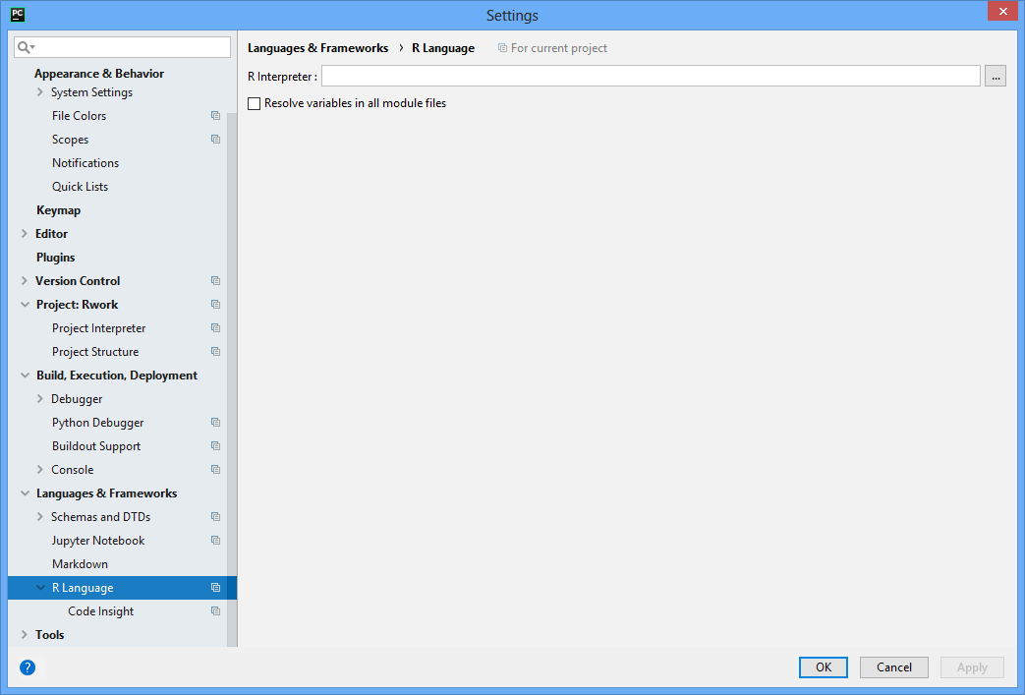
R settings
Ctrl+ Alt+S
Settings , R language, set interpreter, eg: C:\R\R-3.5.0\bin\R.exe

Slide 4

From this to R compatible in Few minutes. Need to Restart pycharm again

Slide 5
Other Than Pycharm
Visual studio Professional / community / enterprise edition

Slide 6
pycharm
Run : cltl+shit+F10
Test run
Print(getwd())
Save file name eg: csvread.R
( Explain this to students !!)

Slide 7
print(is.data.frame(data)) #paste("Columns",ncol(data)) cat(sprintf("Number of Columns: %s\n", ncol(data))) cat(sprintf("Number of Rows: %s\n", nrow(data))) cat(sprintf("Dimension %s\n", dim(data)))

Slide 8
print(paste0("Hai", dim(data)))

Slide 9
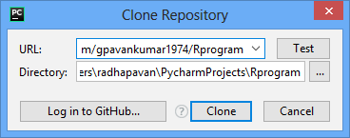
GIT HUB

Slide 10
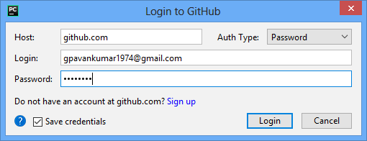

Slide 11
git
Upload files from pycharm
https://git-scm.com/download/win ( 64 bit)
https://desktop.github.com/

